Slide 1
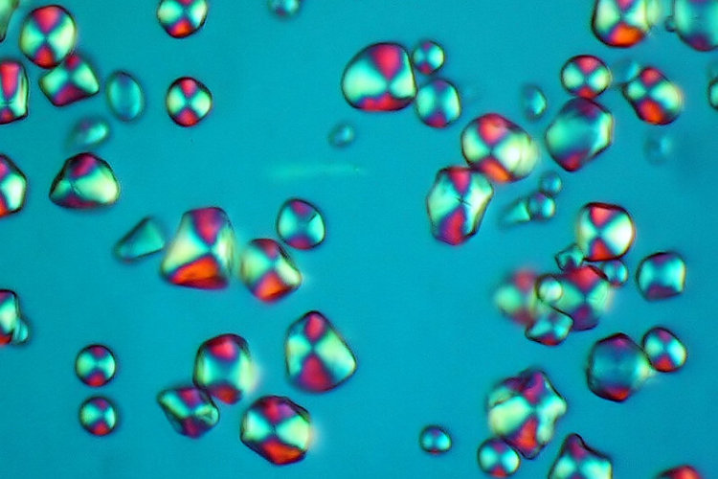
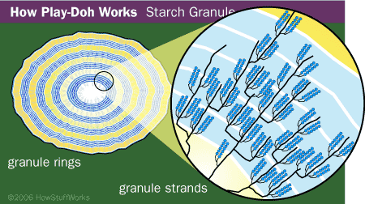
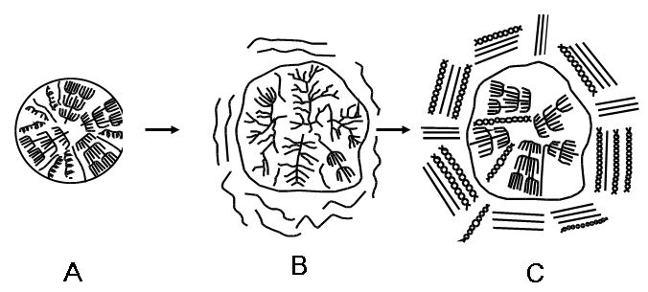
Effect of Temperature on Rheological Properties of Corn Starch
Tamara Dapčević, Miroslav Hadnađev
Institute for Food Technology, Bulevar cara Lazara 1, 21000 Novi Sad, Serbia
Introduction
During the feed manufacturing process ingredients are subjected to mechanical (rolling, crushing, grinding), thermal (roasting, micronizing) or thermo-mechanical (flaking, popping, extruding) processes into dry or wet (steam rolling, steam crushing, steam flaking, pressure toasting, steam extruding, pelleting) conditions. These processing conditions promote physical and chemical changes in ingredients, including the gelatinization of starch.
Starch gelatinization includes the diffusion of water into a granule, hydration and swelling, uptake of heat, loss of crystallinity, and amylase leaching. Leached amylose forms double helices that may aggregate (hydrogen bond) to each other and create semicrystalline regions. As the gelatinized starch cools, the dispersed matrix forms a gel or paste.
The objective of the study was to evaluate different levels of starch pasting produced by different processing temperature on rheological behaviour of starch pastes and gels. Rheological assessment of starch pastes and gels was performed by using fundamental methods, which included flow curve and small deformation (dynamic oscillatory) measurements. In order to study the structural aspects of starch pasting, microphotography recording was used for the integration of the information coming from rheological measurements.
Results
Graph 1. Viscoamylogram curve of 9% starch suspension
Graph 2. Microscopic structure of starch suspension (A) and 9% starch gel prepared at T_{min} (B), T_{sr} (C) and T_{max} (D)
Conclusion
At different processing temperatures different levels of starch pasting occurred, influencing the rheological behaviour of obtained starch pastes and gels. With the help of microstructural analysis the colloid structure of the obtained gels was revealed. Corn starch gel is a two-phase disperse systems consisting of swollen or destroyed starch granules embedded in the network of macromolecular chains bonded to one another. The results showed that gel prepared at higher temperature, showed the greater extent of thixotropy (larger thixotropic loop area) as well as the highest shear stress (apparent viscosity), rigidity (modulus of elasticity) and resistance to deformation (yield stress). Namely, that gel was stronger which indicates that it was a system with three-dimensional network structure. On contrary, gel prepared at lower temperature had smaller thixotropic loop area, and lower value of shear stress, modulus of elasticity and yield stress which is typical of weak gels consisting of a suspension of swollen starch granules and macromolecules.
Acknowledgements:
This work was financially supported by Ministry of Science and Technological Development, Republic of Serbia (project no. 20066).
Graph 3. Flow curves of 9% starch gels prepared at different temperatures
Materials and methods
Starch pastes and gels = Corn starch + Deionised water
Brabender Viscoamylograph (Duisburg, Germany) - for sample preparation and determination of characteristic temperatures and viscosities during the pasting process
HAAKE RheoStress600 rheometer (Thermo Scientific, Karlsruhe, Germany) - for determination of rheological properties of starch pastes and gels
Optical microscope (TP-1001C topica ccd camera, Kruss) - for investigation of microscopic structure of the gelatinized starch
Graph 4. Oscillatory stress sweep measurements of 9% starch gels prepared at 73, 84.5 and 95 °C
14th International symposium on feed technology and 2nd Feed-to-Food Workshop, Novi Sad, Serbia
19 - 21 October 2010

